Slide 1
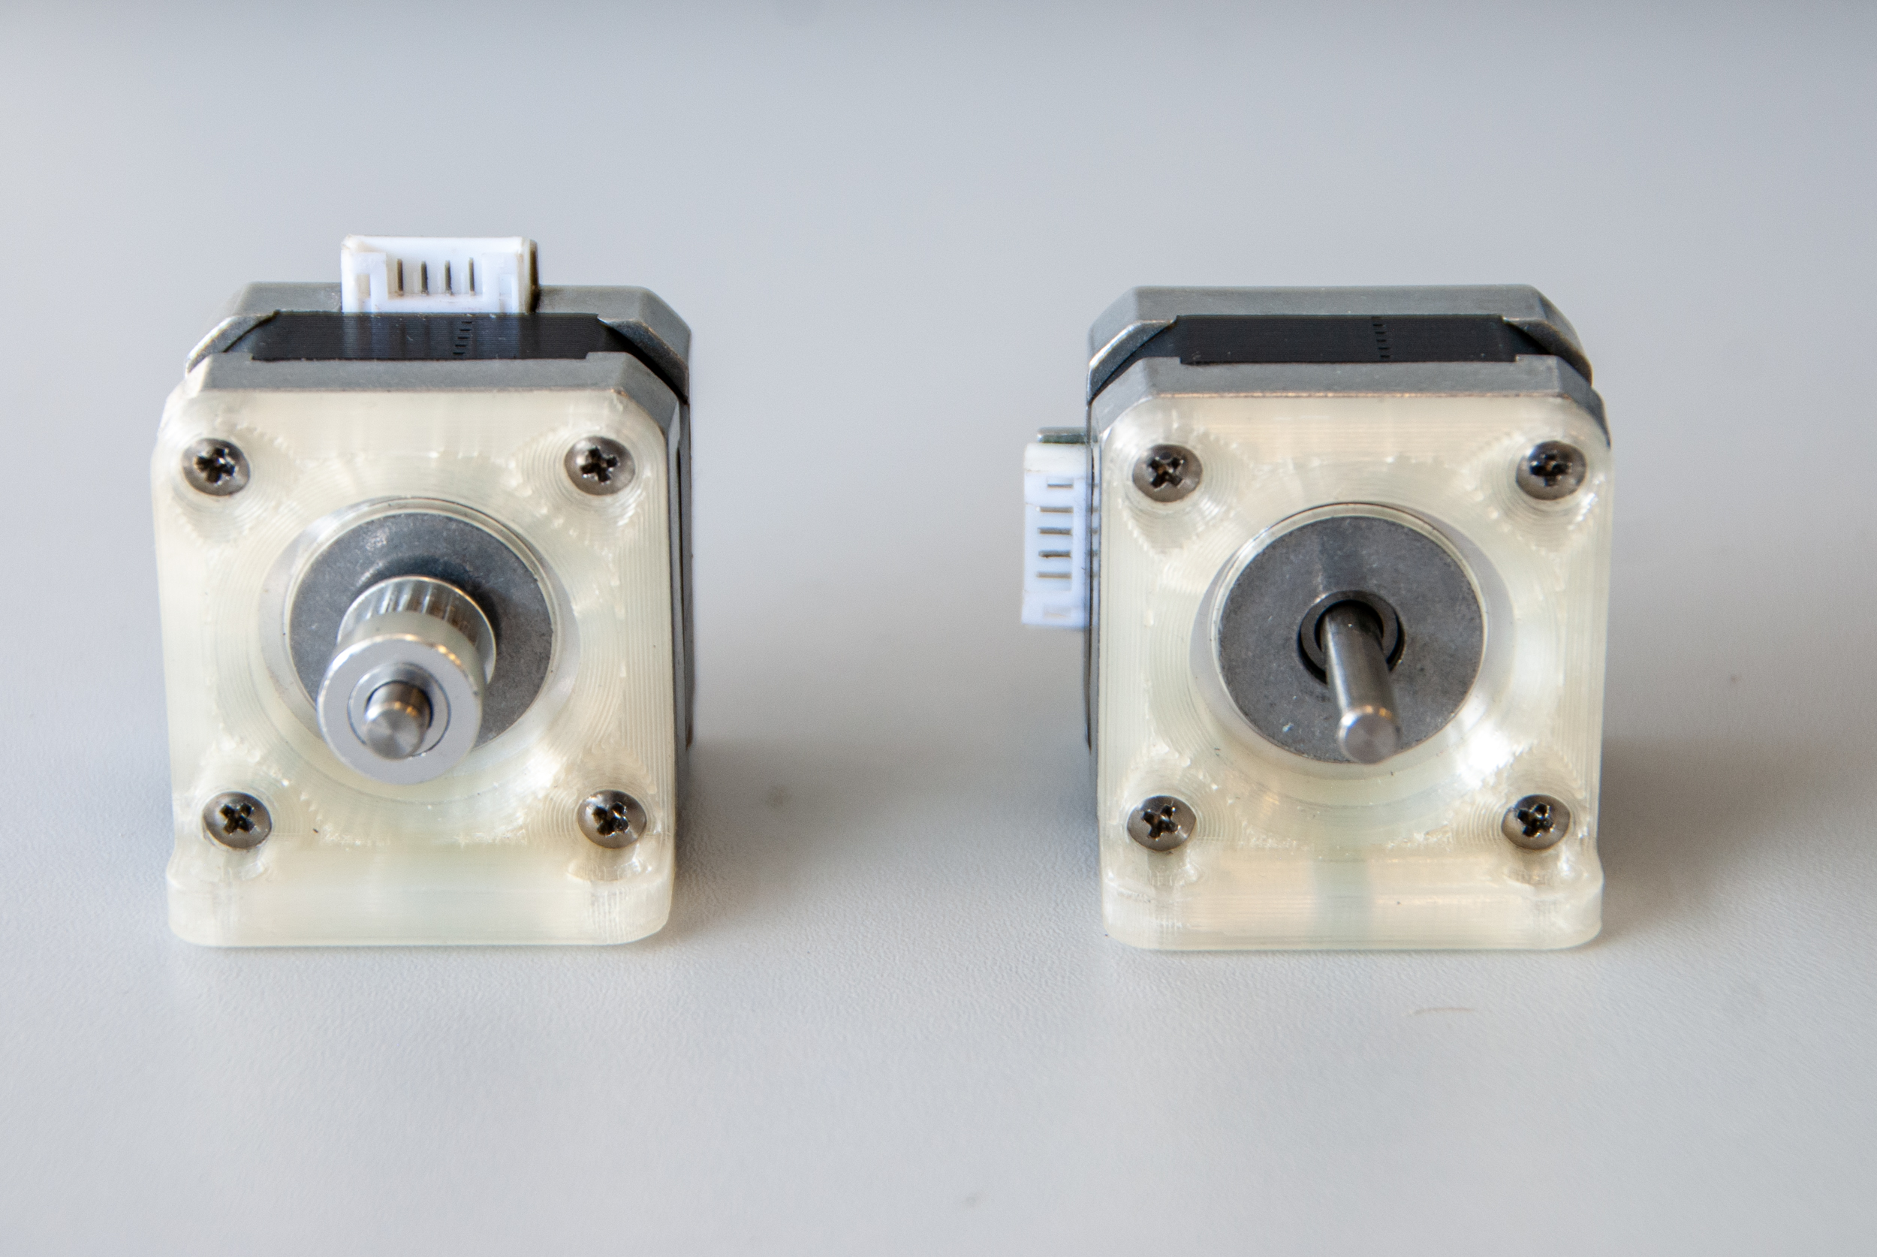
Vertically oriented pins
GT2 Pulley
Camera motor
Axial motor

Slide 2
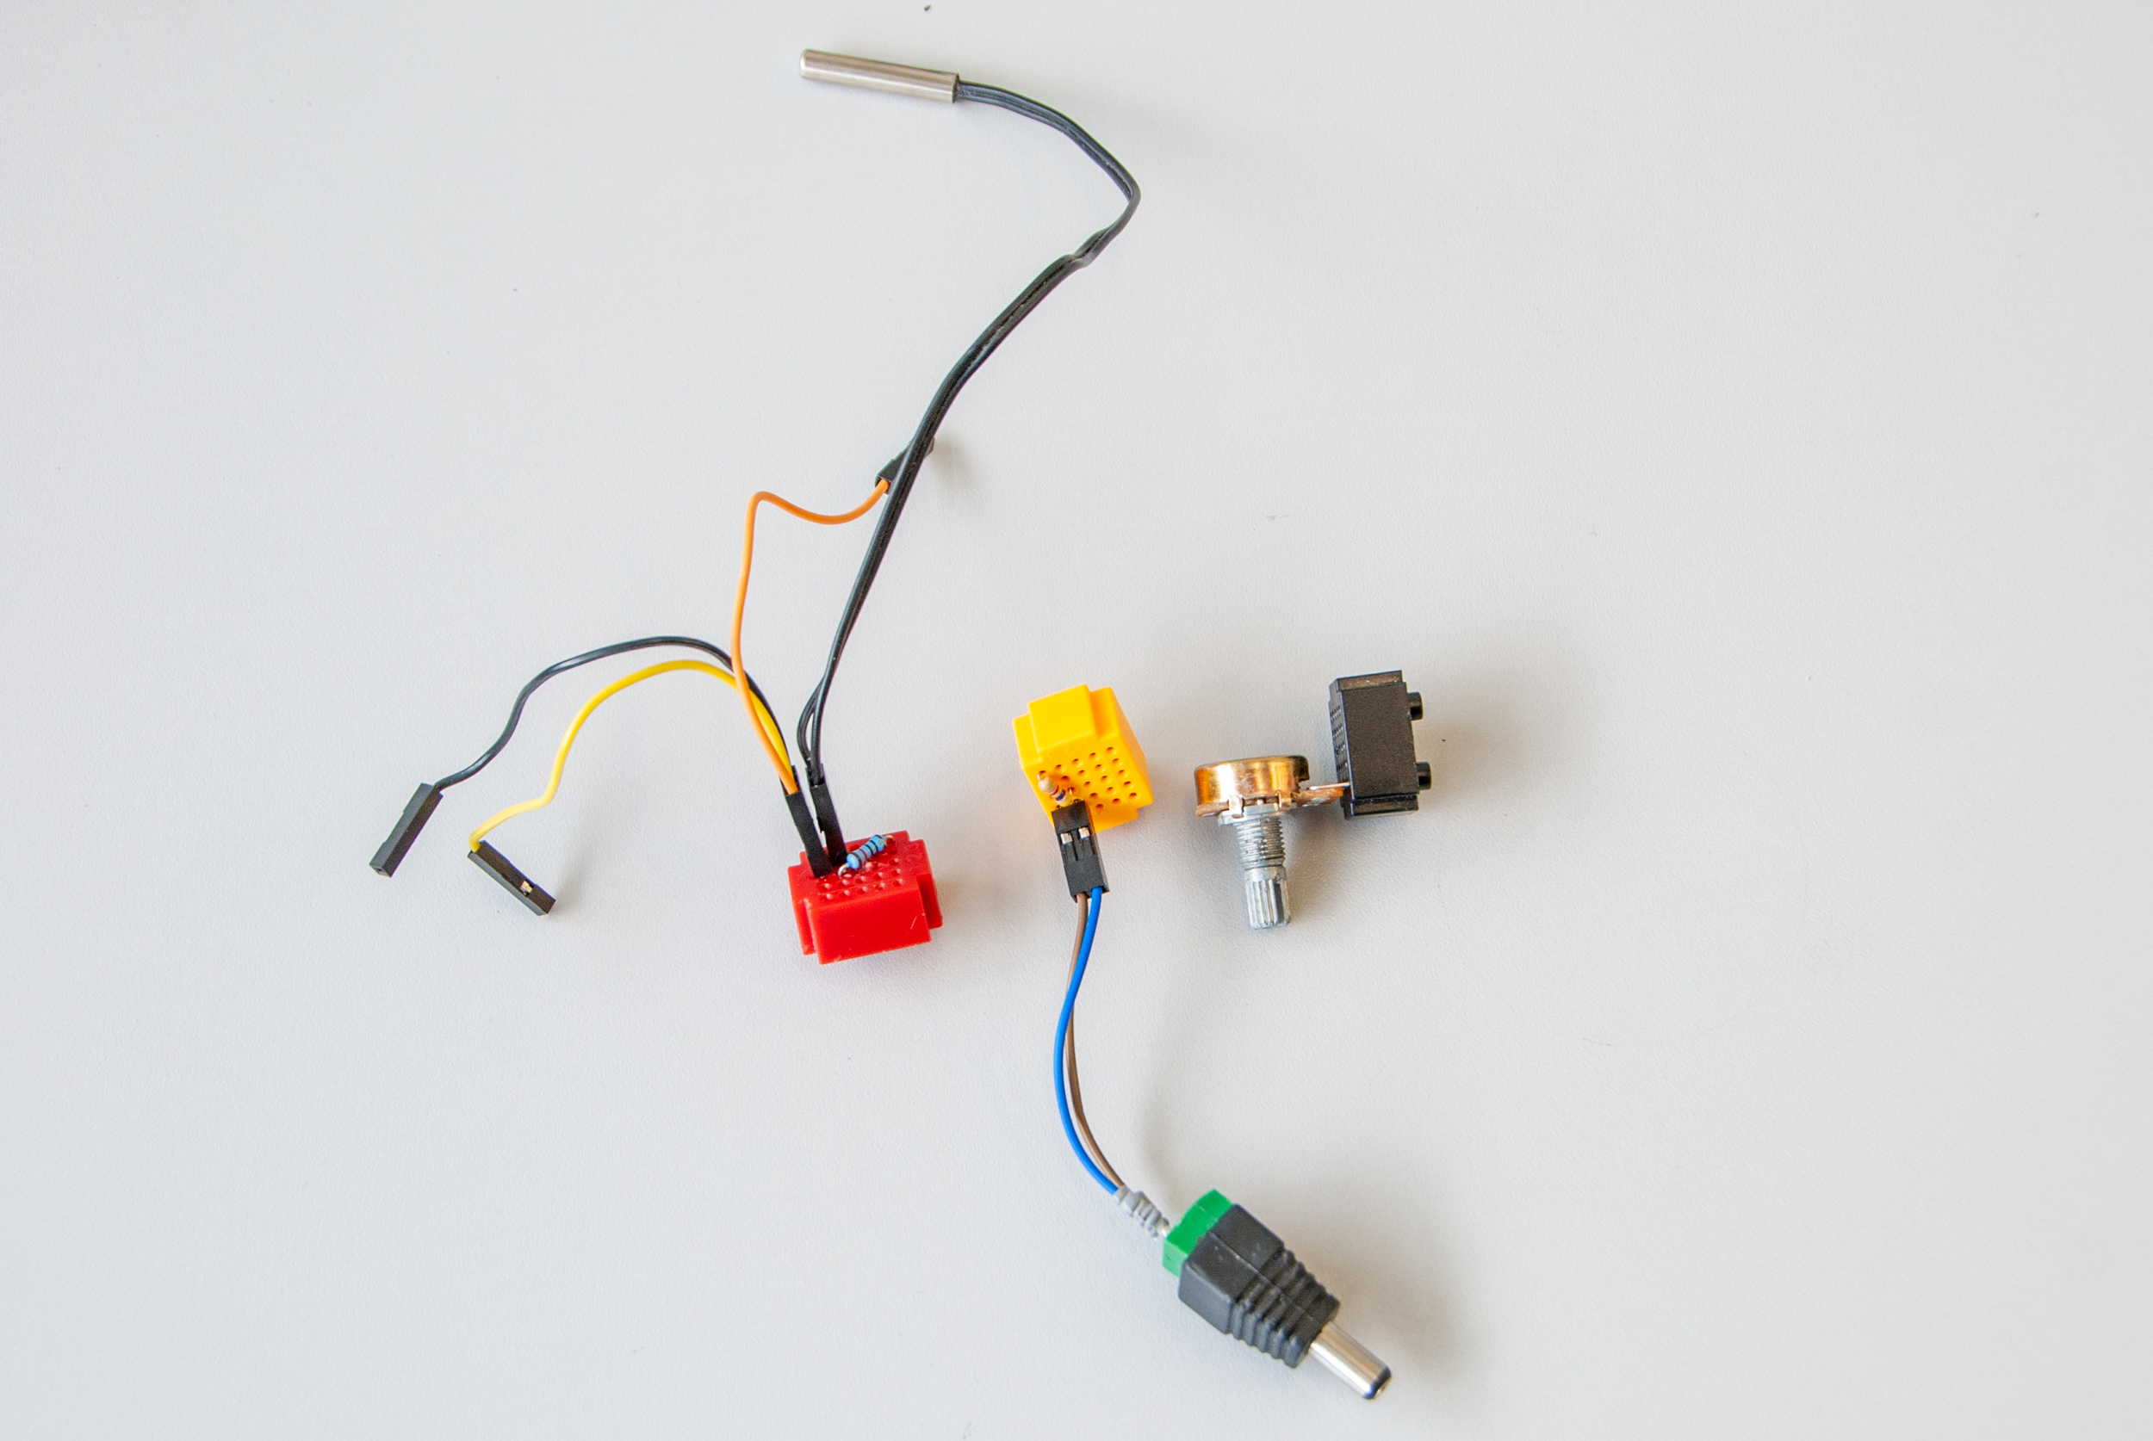
10 kΩ NTC
5 V
trigger IN
analog IN
10 kΩ
4.7 kΩ
GND
10 kΩ
potentiometer
thermistor

Slide 3
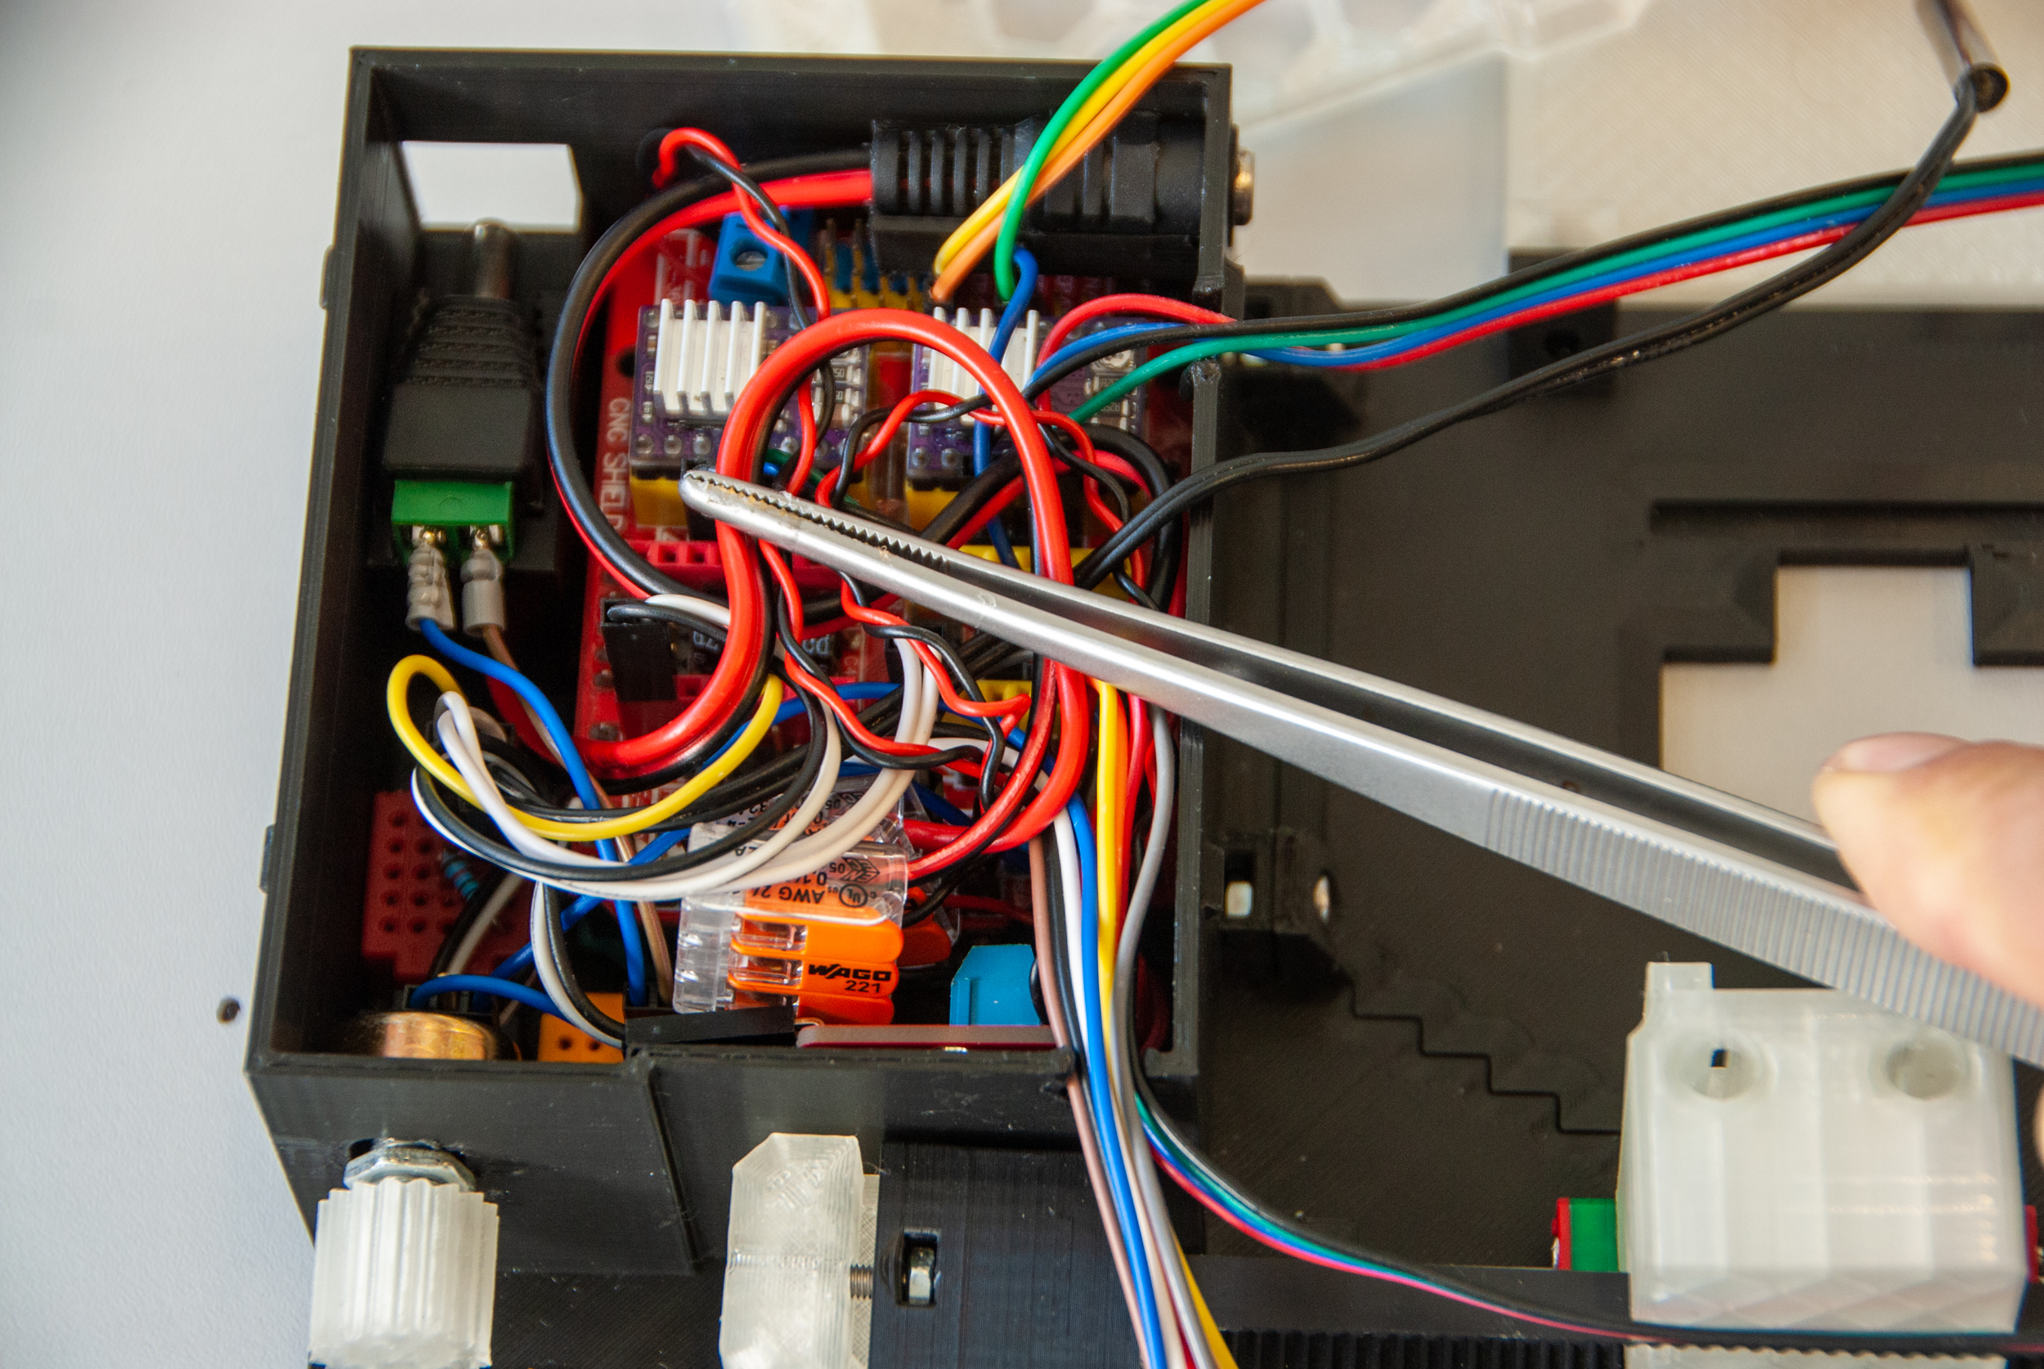
GND
5 V

Slide 4
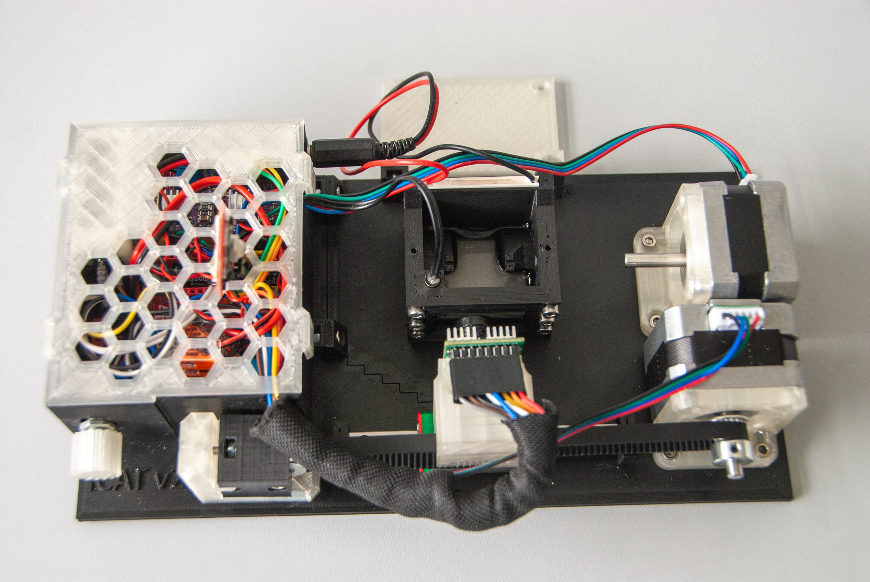
Mounting plate
Chamber
Focus adjustment ring
Camera
Heating adjustment knob

Slide 5
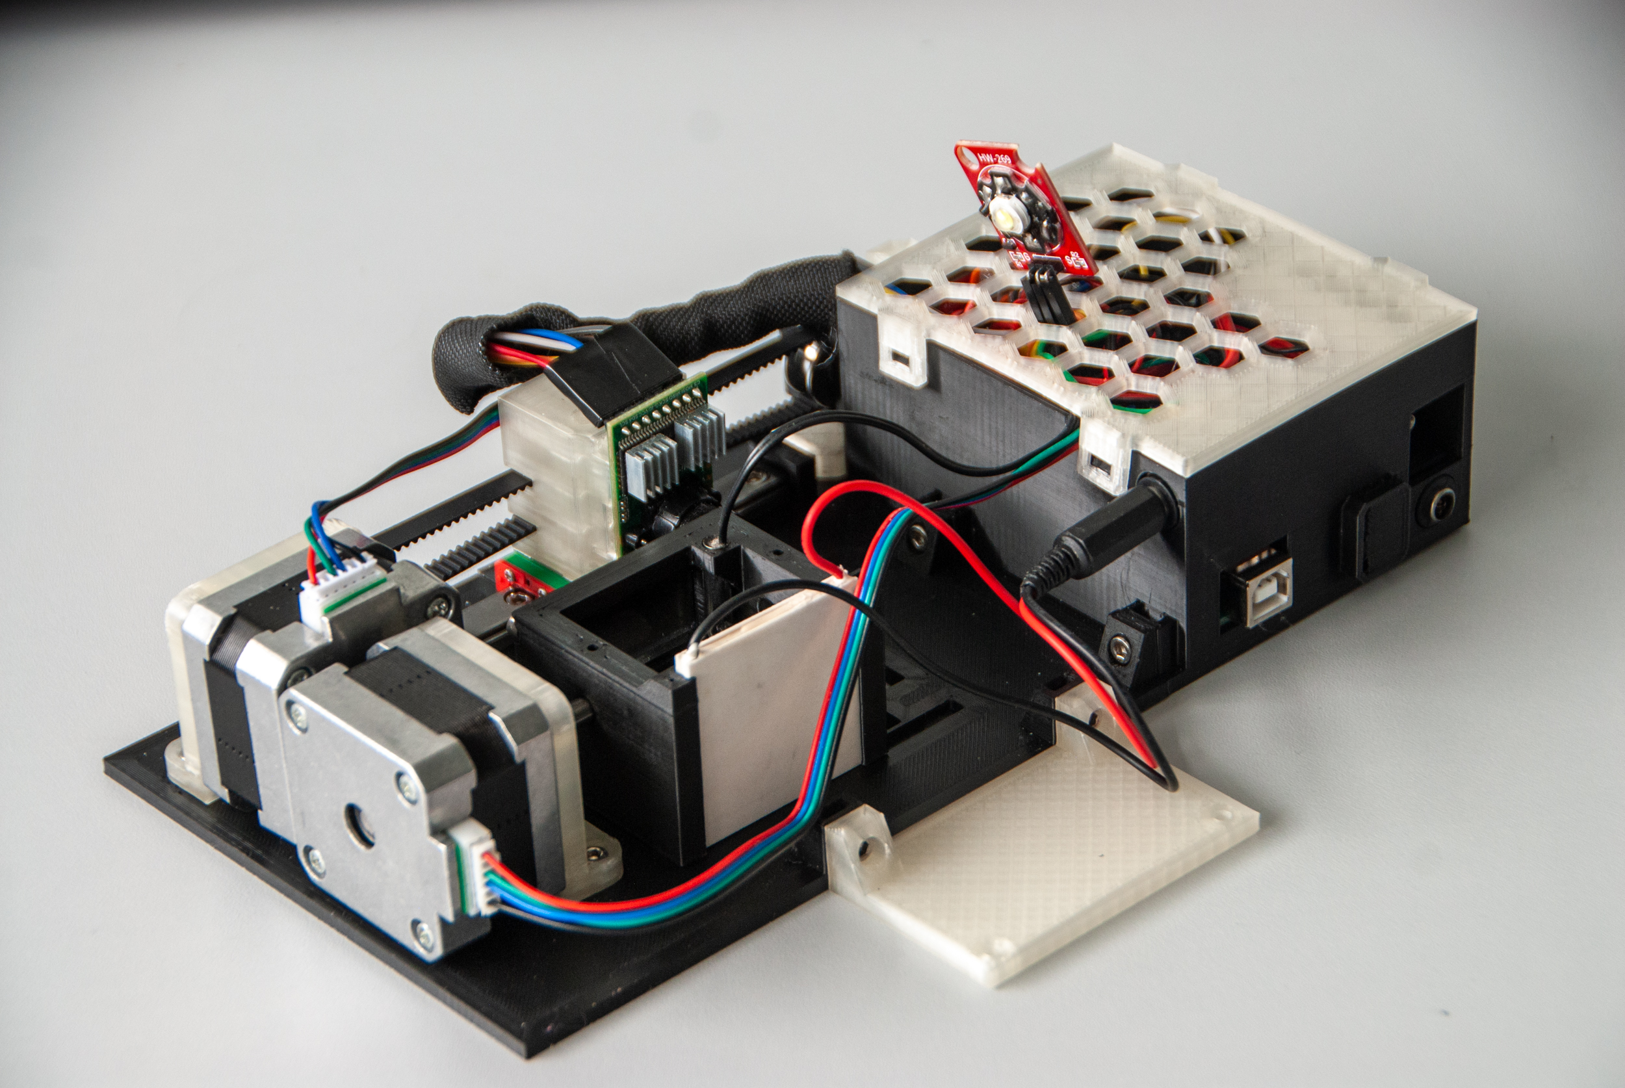
Trigger IN
Peltier OUT
Arduino UNO
Main Power 12 V

